Slide 1
Days of Future Past

Slide 2
Overview and Architecture
AWS Service
S3 Bucket Web Page, Photos
Conigto User Info
EC2 ML algorithm
API Gateway Access Control
Lambda Function Backend Logic
MongoDB Store Photo Id

Slide 3
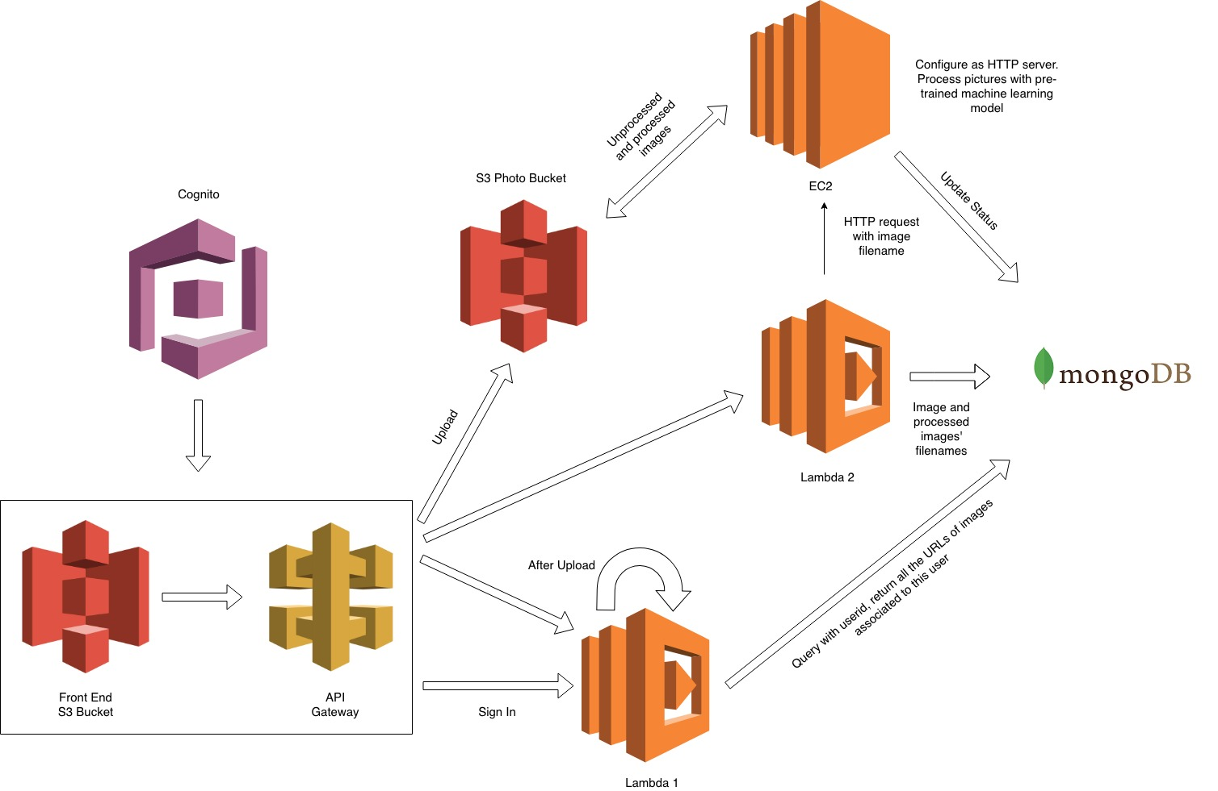

HELLO!
I am Jayden Smith
I am here because I love to give presentations.
You can find me at @username

Slide 4
Lambda Functions
Lambda1
enables the frontend to retrieve the most updated data from the backend database (mongoDB)
Lambda2
updates the information in the database and notify EC2 when a new image is uploaded in

Slide 5

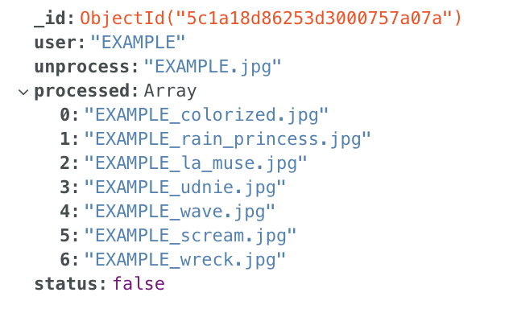
User Info and Database
Cognito
MongoDB

Slide 6
Deep Learning for Coloring and Style Transfer

Slide 7
DEMO

